Slide 1
Zillow data science pipeline
Notes:
Pour changer le logo en pied de page, aller dans AFFICHAGE > Masque > Masque des diapositives : remplacer le logo en place par le logo de votre entité.
Pour éditer la mention de confidentialité, aller dans le menu INSERTION > En-tête et pied de page, et remplir le niveau désiré.

Slide 2
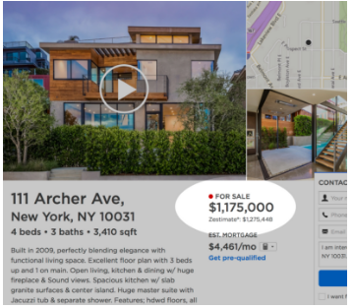
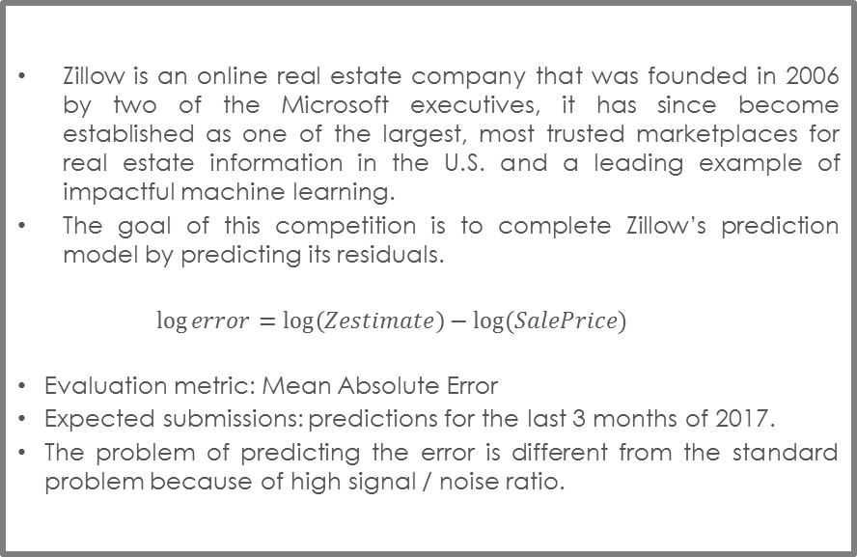
Zillow’s Home Value Prediction
Competition description
Competition description
Zillow is an online real estate company that was founded in 2006 by two of the Microsoft executives, it has since become established as one of the largest, most trusted marketplaces for real estate information in the U.S. and a leading example of impactful machine learning.
The goal of this competition is to complete Zillow’s prediction model by predicting its residuals.
$$\log{error}=\log\left(Zestimate\right)−log⁡(SalePrice)$$
Evaluation metric: Mean Absolute Error
Expected submissions: predictions for the last 3 months of 2017.
The problem of predicting the error is different from the standard problem because of high signal / noise ratio.
Training Set |  |  |  | LB |  | Training Set |  |  |  | Private Leaderboard
 |  |  | 20/10/2016 |  | 31/12/2016 |  |  |  | 20/10/2017 |  | 31/12/2017

Slide 3
Data structure

Slide 4
Zillow’s Home Value Prediction
Standard Pipeline
Pre-modeling
EDA
Data enrichment
Data imputation & cleaning
Modeling
Simple models
More complexe models
Model tuning
Stacking
Model combinations

Slide 5
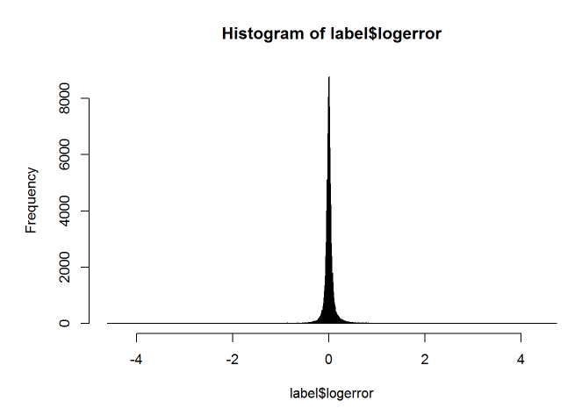
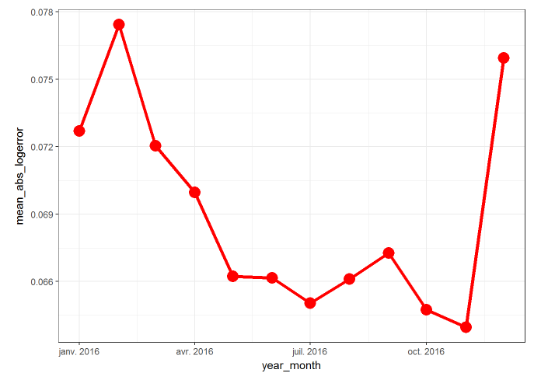
Explolatory Data Analysis
Overview
One can simply put the entire data to a blackbox model and get the results.
But one can also spend time to understand the data hence get the very first ideas for better modelling.
Outliers in the response: capping / collaring could be beneficial.
Necessarity of making several models.
Response variable changes over time -> How to talke this problem.
Try different weights for observations of different months.

Slide 6
Explolatory Data Analysis
Missing value

Slide 7
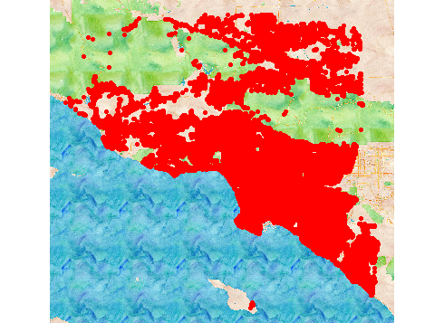
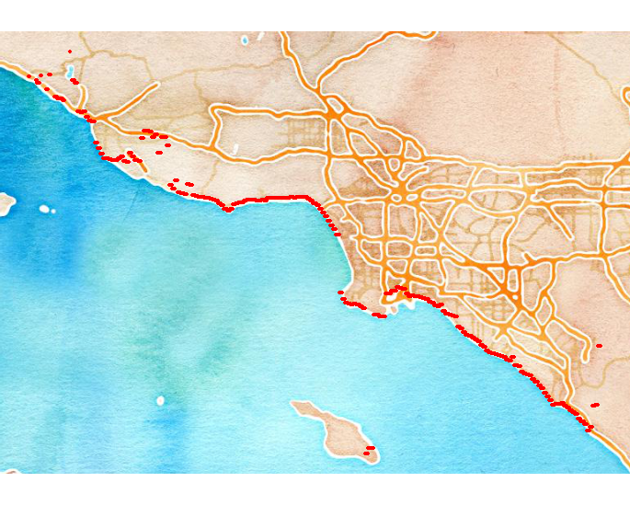
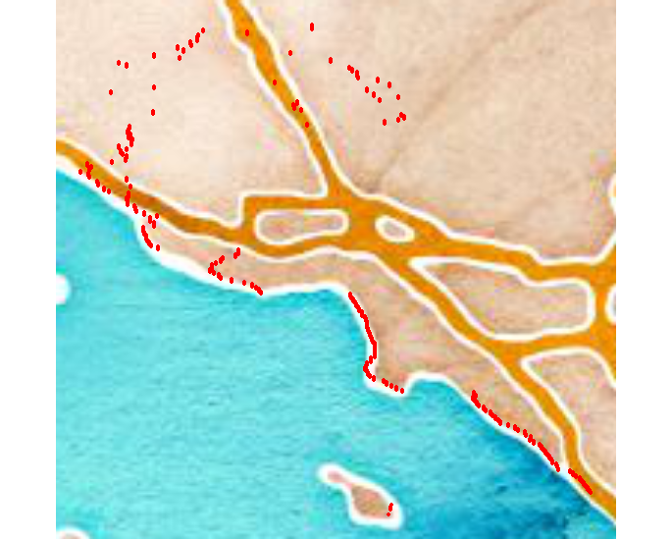
Feature Engineering
Ocean Distance
Ocean distance
The intuition is that the nearer to the coast a house is, the more expensive it becomes.
External data is not allowed, so we need to calculate the longitude / latitude of the coast from the available data.
We can take the
min of longitude by different groups of latitude
Min of the latitude by different group of longitude
And combine them to have the desired information without using external data

Slide 8
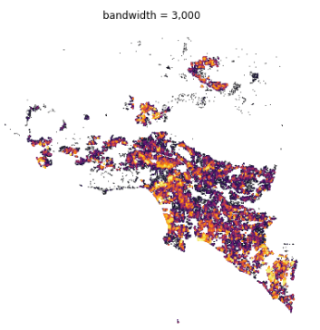
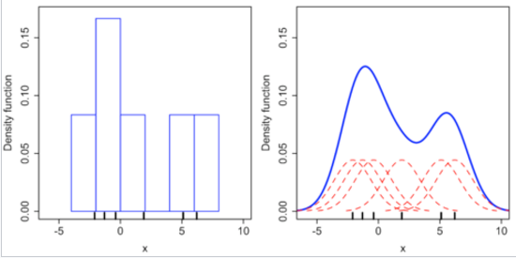
Feature Engineering
Parcel Density
Kernel Density Estimation
Kernel density is the non-parametric estimation of the probability density function (PDF) of a given data point.
Example of 1-dimension KDE:
The data points here are the geographical coordinate of the houses.
The non-parametic nature of the technique allows us to easily fit the data on a 2-dimension space and on each local segmentation.
It gives us an additional information of how concentrated the parcel is, independently from the pre-defined geographical zone.
Reference: https://en.wikipedia.org/wiki/Kernel_density_estimation

Slide 9
Modelling
Penalized Regression Models
4.Modelling phase 1
5.Modelling phase 2
.Building simple models on the whole data:
Lasso regression
Ridge regression
Elastic net
Tree bases models:
Random Forest
Gradient Boosting
.Initial guest: Zillow model already doing well on the traditional variables (not the longitude and latitude).
So we can:
First, fit all the traditional variables to the zestimate residuals to complete Zillow model
Fit the second model only on longitude & latitude
With splines
6.Modelling phase 3
.Building 3 different models for 3 different cities, as the impact of each predictor on the price is not the same between each city.
Building n models for n clusters build in the [3]

Slide 10
Penalized Linear Models
LASSO

Slide 11
Penalized Linear Models
Ridge & Elastic Net

Slide 12
Clustering

Slide 13
GBDT family
GBM

Slide 14
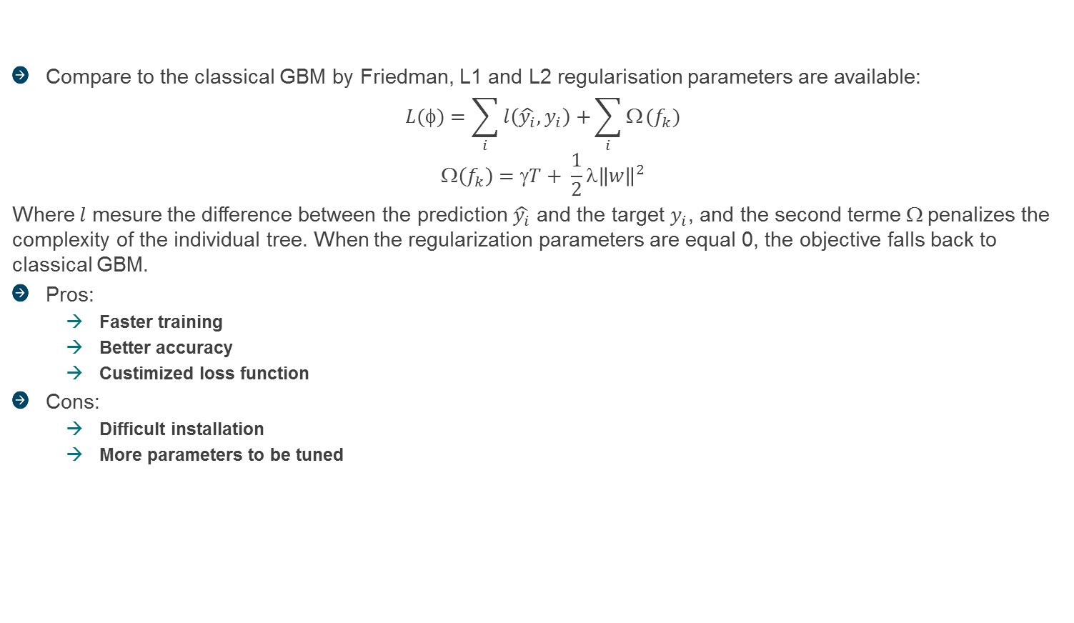
GBDT family
XGBoost (Penalized Gradient Boosting)
Compare to the classical GBM by Friedman, L1 and L2 regularisation parameters are available:
$$L(φ)=\sum_{i}{l\left(\hat{y_{i}},y_{i}\right)+}\sum_{i}{Ω}(f_{k})$$
$$\left(f_{k}\right)=γT+ \frac{1}{2}λ{\left\|w\right\|}^{2}$$
Where $l$ mesure the difference between the prediction $\hat{y_{i}}$ and the target $y_{i}$, and the second terme $$ penalizes the complexity of the individual tree. When the regularization parameters are equal 0, the objective falls back to classical GBM.
Pros:
Faster training
Better accuracy
Custimized loss function
Cons:
Difficult installation
More parameters to be tuned

Slide 15
GBDT family
Dynamic Boosting - Catboost
GBM, XGBoost, LightGBM are susceptible to a bias in a pointwise gradient estimates that lead to reduced accuracy.
Catboost proposes a dynamic boosting approach that avoids the esimation bias at a minimal cost of variance.
Catboost can outperform tuned GBM, XGBoost, LightGBM even with its default parameters.
Catboost works well with categorical features.
Catboost doesn’t have good training time.

Slide 16
Stacking

Slide 17
Resumé

